Slide 1
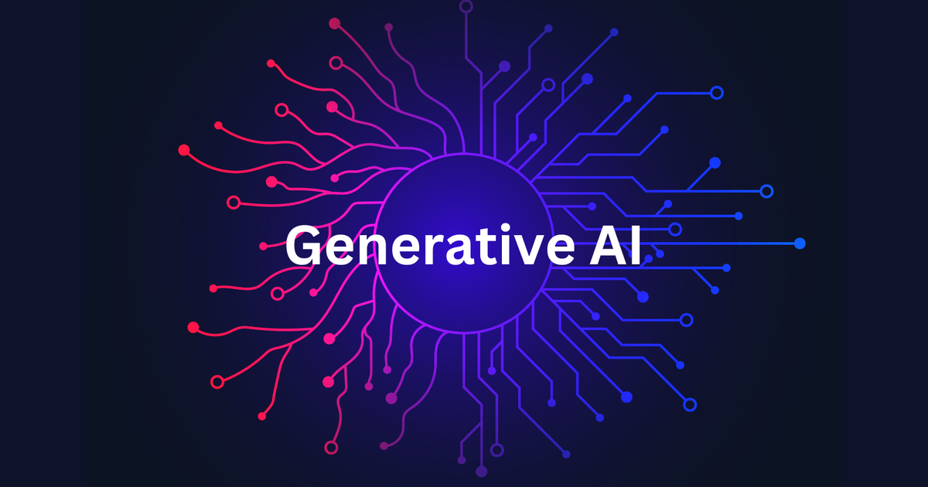
SUBMITTED BY ASMIT BRANCH : AIML ROLL NO : 2322811 SUBMITTED TO : MR DEVASHISH SIR

Slide 2
INTRODUCTION
Generative AI is a branch of artificial intelligence that focuses on creating systems capable of generating new content, such as text, images, music, or even complex data patterns. Unlike traditional AI, which typically classifies or predicts based on existing data, generative AI creates novel outputs based on learned patterns.

Slide 3
GENERATIVE TYPES
.
Text Generation : It helps to generate text or any text related queries.
Video Generation : It creates video content using AIML techniques. It includes synthesis of new frame, animation or transformation of existing footage.
Code Generation : It automatically generates source code they are template based models code generation.

Slide 4
Image Generation : It refers to the process of creating new images using artificial intelligence and machine learning.
Music Generation : It is a process of creating new music using Artificial Intelligence and Machine Learning .It provides personalization , background music , educational tools.

Slide 5
APPLICATIONS
Text : Chat GPT , Google’s neural network machine translation
VIDEO : synthesia , veed.io
IMAGE : craiyon , google’s deep dream , bing
MUSIC : magenta , aiva
CODE : github copilot , amazon code whisperer

Slide 6
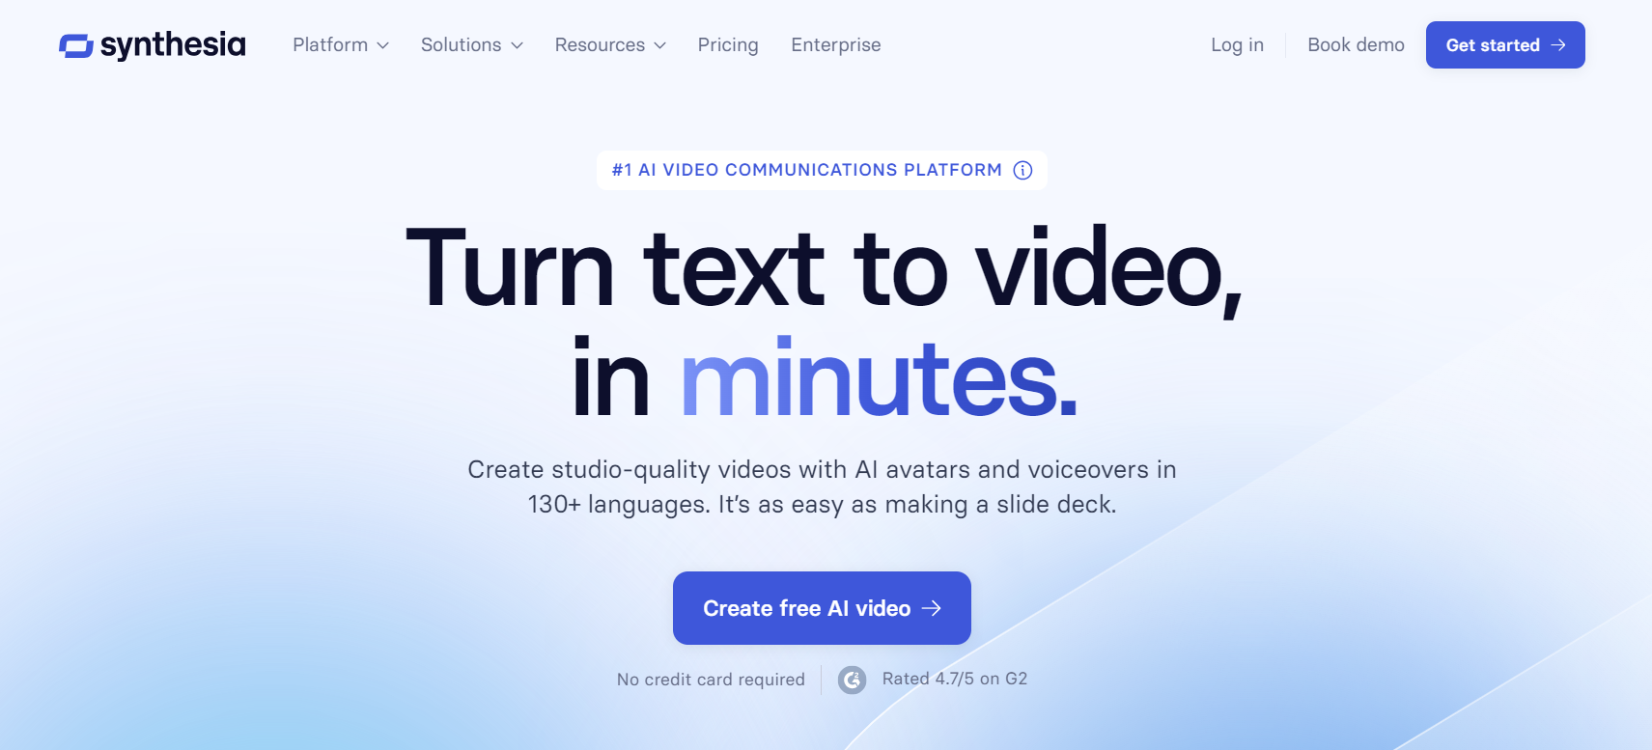
Synthesia
Provide wide range of video content reducing time, cost, complexity. It includes personalized avatars and voiceover without needing traditional video production tools.

Slide 7
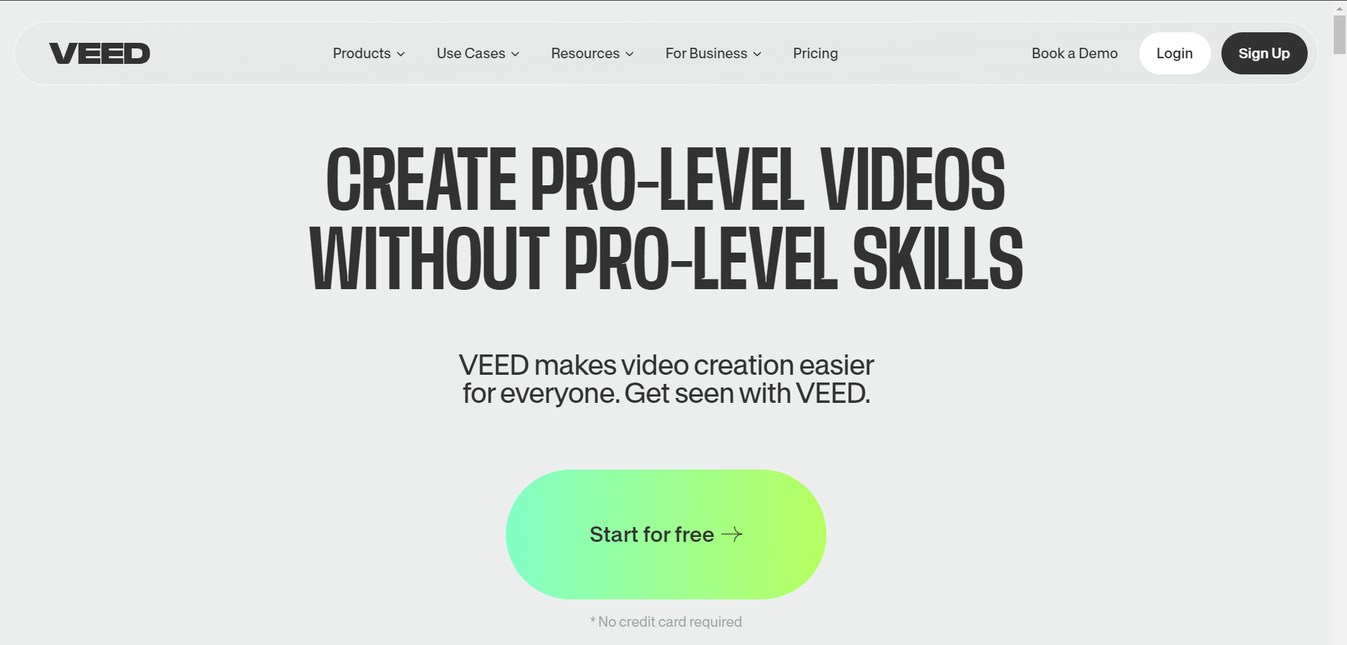
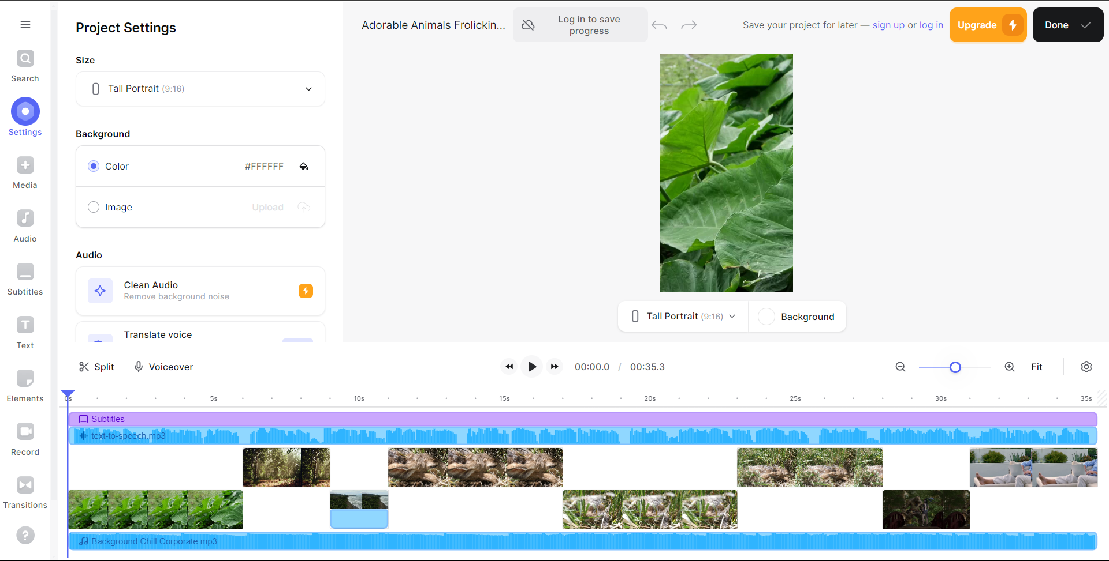
Veed.io
It is a video editing tool that allows user to create, edit and share videos with ease. It offers features like automatic subtitles, video trimming, adding text and animations, and converting audio to text.

Slide 8

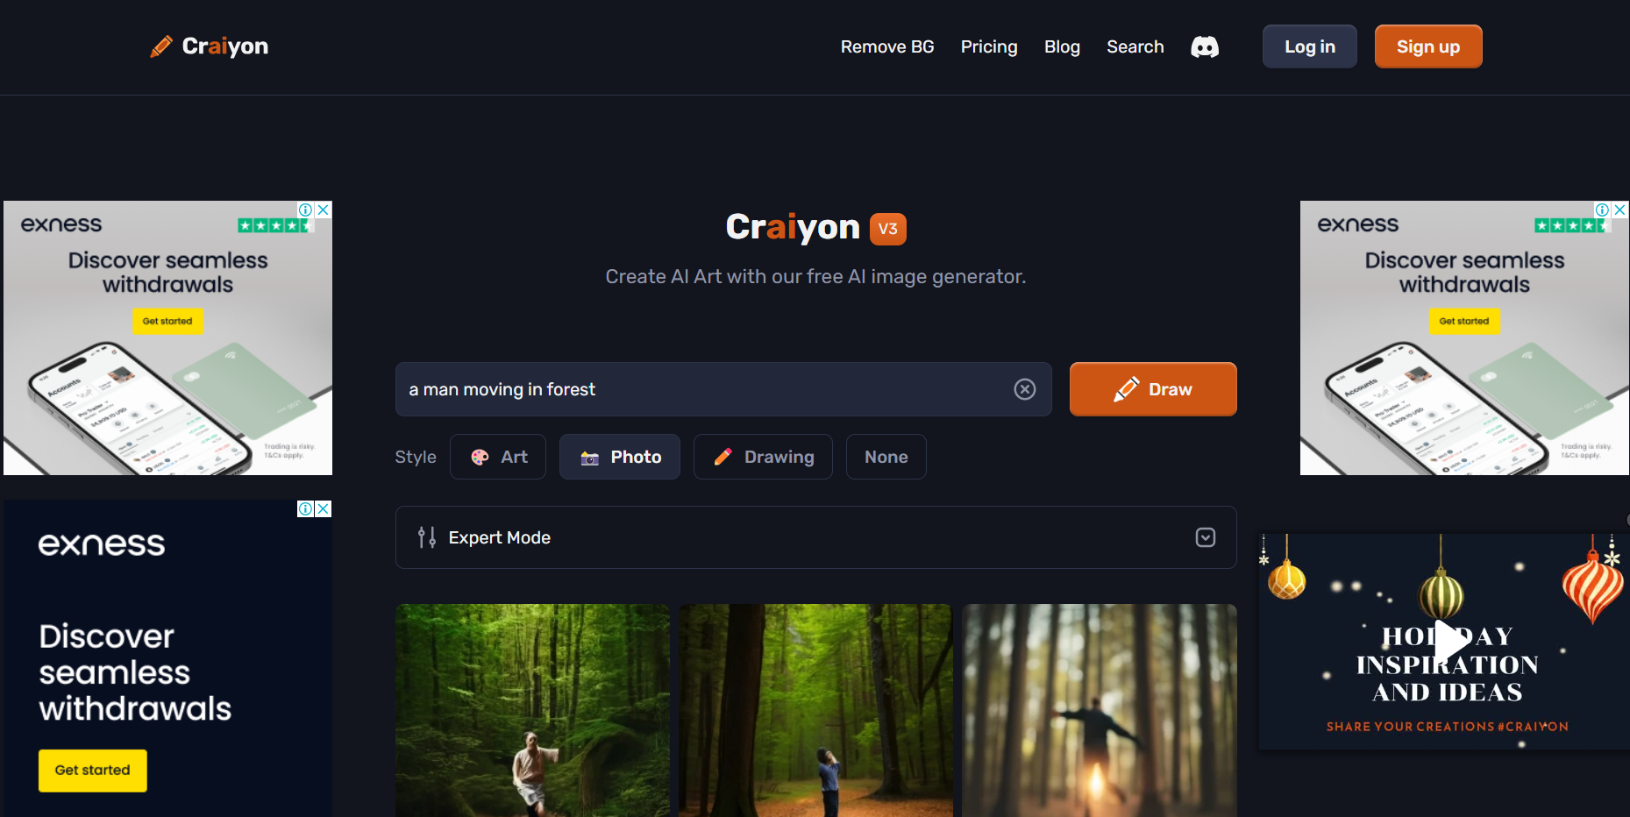
craiyon
• Generate images using textual description or detailed images based on input prompts.

Slide 9

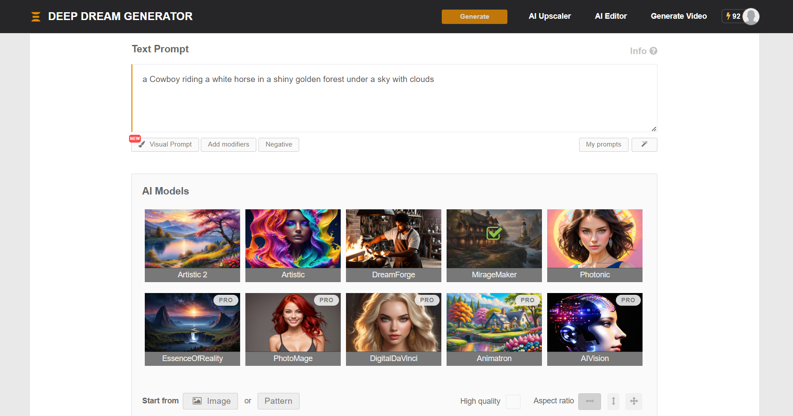
Google’s Deep Dream
It is a computer vision program uses deep learning to find and enhance the pattern in images via algorithm thus, creates dream like appearance

Slide 10

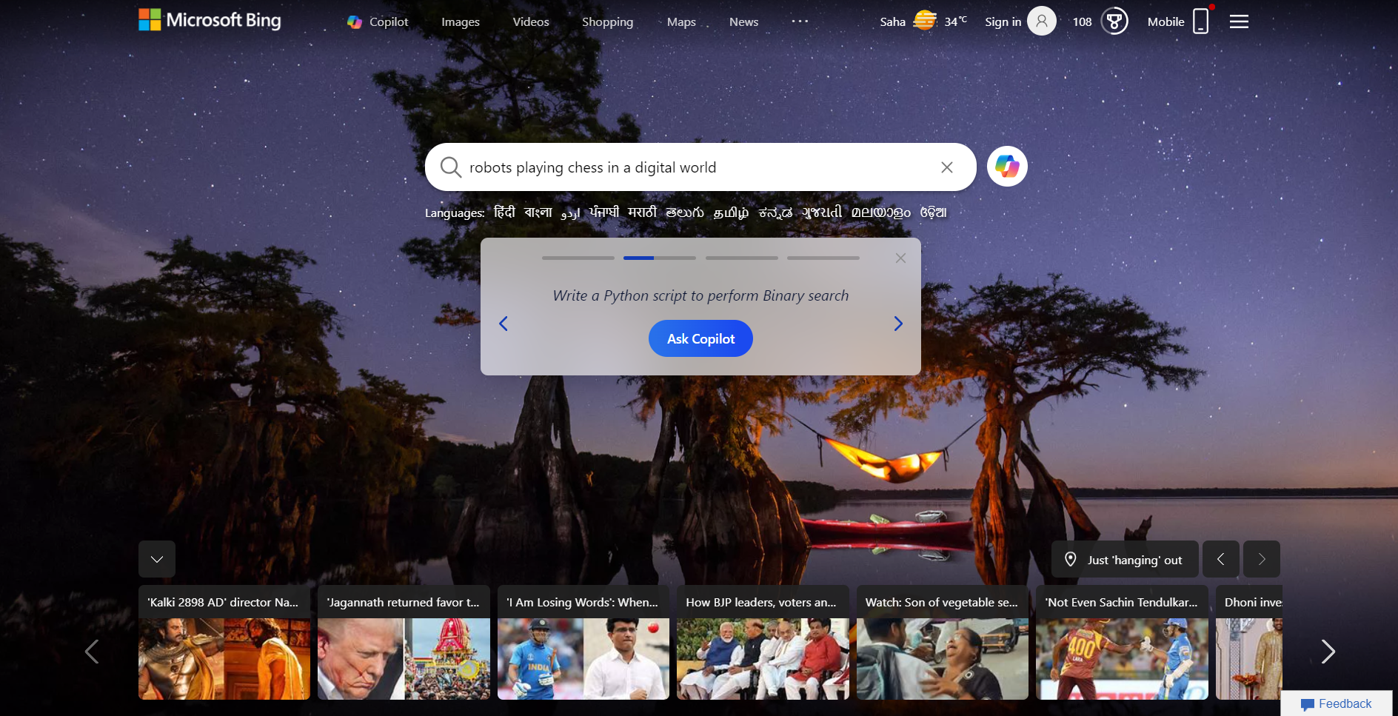
bing
It is a Microsoft search engine you can use it for web search, image search , news and much more.

Slide 11
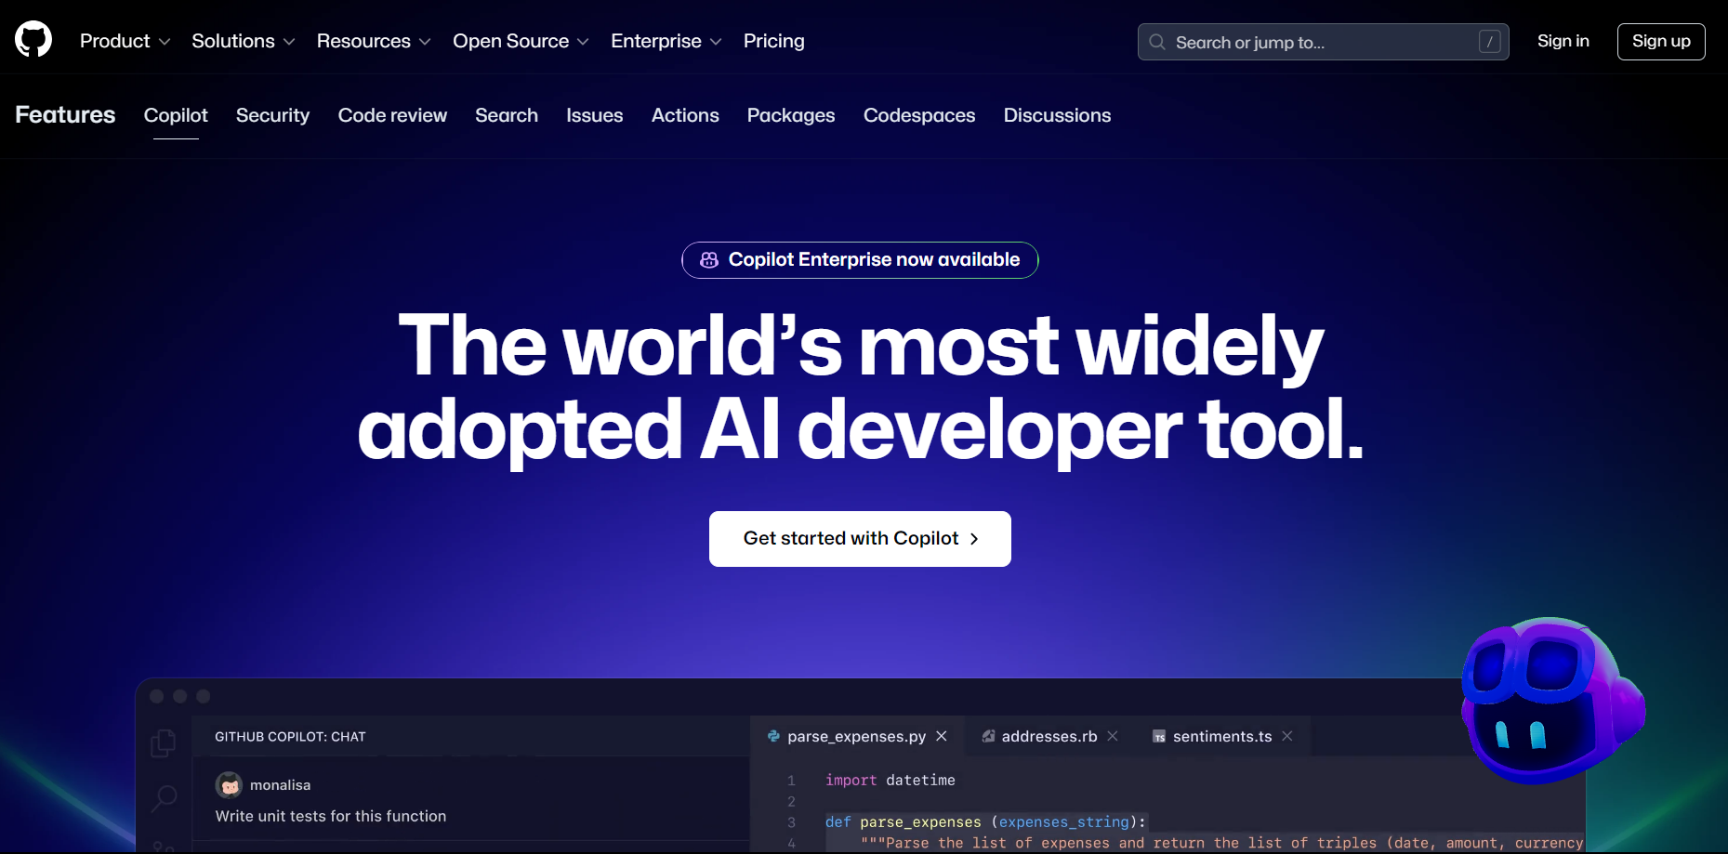
Github Copilot
• It is a AI powered code completion tool it assist developers in writing code faster and more efficiently.

Slide 13


